Slide 1

Traffic Light Controlling System using Applet and Graphics
Presented by –
Group No – 1 Guided by-
1. Wani Pushpak Shrikant Prof. G. N. Handge
43. Raut Atharva Satish
45. Savant Omkar Vitthal

Slide 2
Contents:
Introduction
History
Algorithm
Flowchart
Output
Analysis
Conclusion

Slide 3
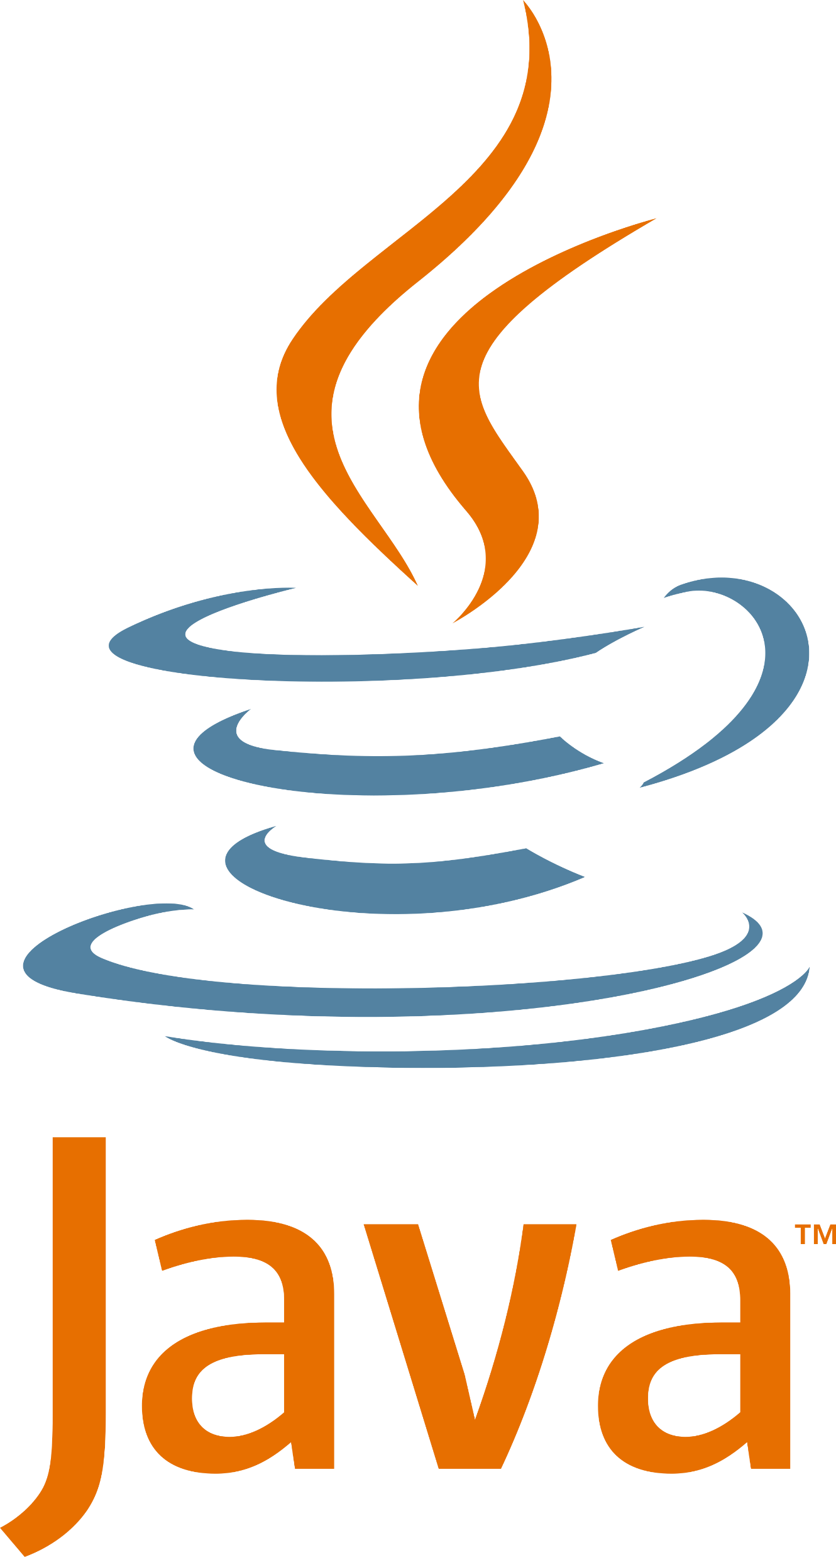
Java
Java is a powerful general-purpose programming language.
It is used to develop desktop and mobile applications, big data processing, embedded systems, and so on.

Slide 4

History
The principles for creating Java programming were "Simple, Robust, Portable, Platform-independent, Secured, High Performance, Multithreaded, Architecture Neutral, Object-Oriented, Interpreted, and Dynamic".
It was intended to let application developers write once, run anywhere (WORA)meaning that compiled Java code can run on all platforms that support Java without the need for recompilation.

Slide 5
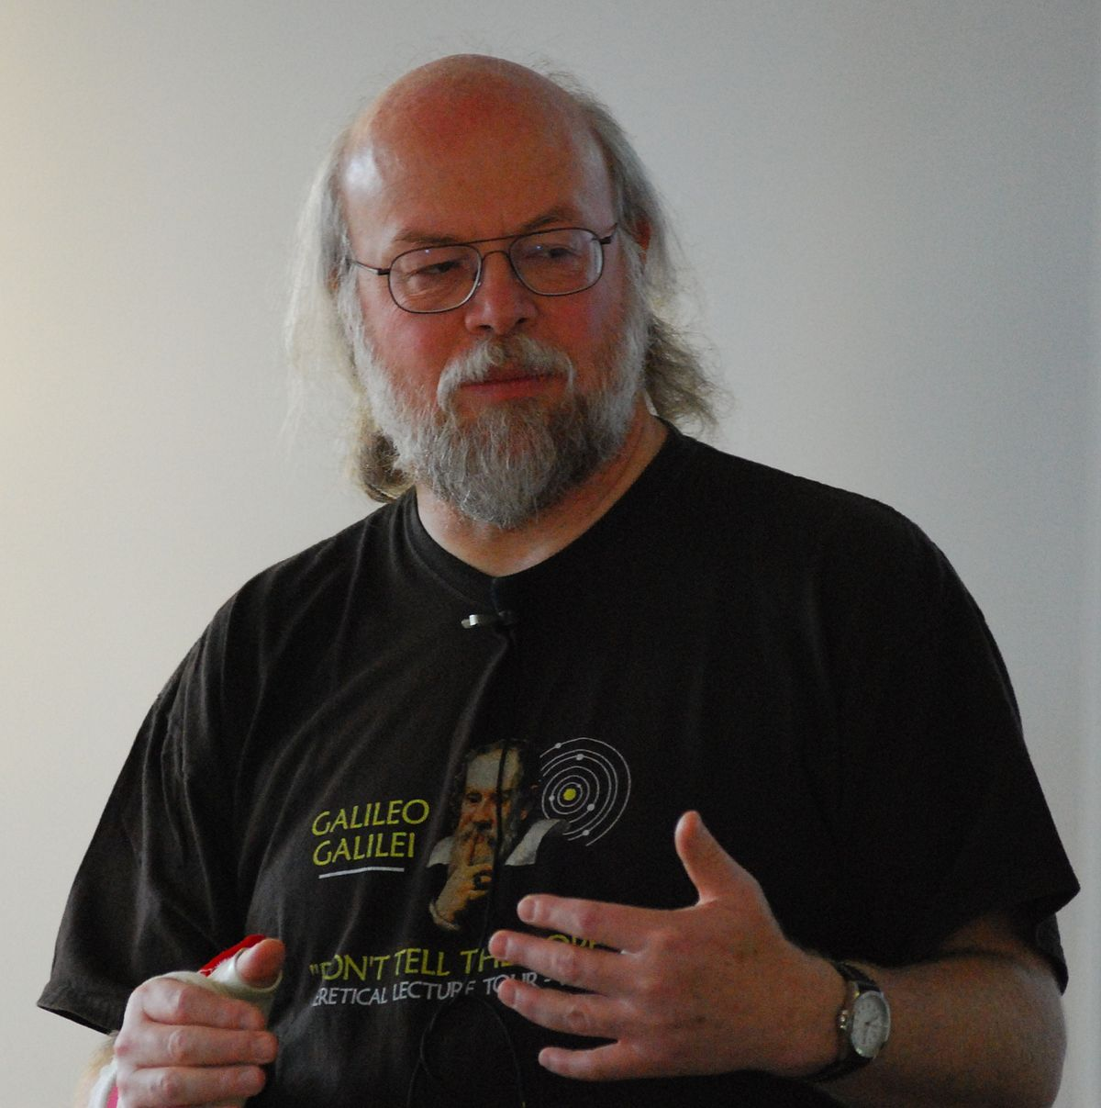
James Gosling

Slide 6
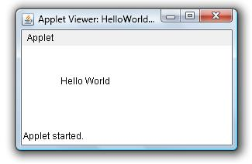
Applet
Applet is a special type of program that is embedded in the webpage to generate the dynamic content.
It runs inside the browser and works at client side.

Slide 7

History
The word applet was first used in 1990 in PC Magazine.
However, the concept of an applet, or more broadly a small interpreted program downloaded and executed by the user, by Jeff Rulifson.

Slide 8
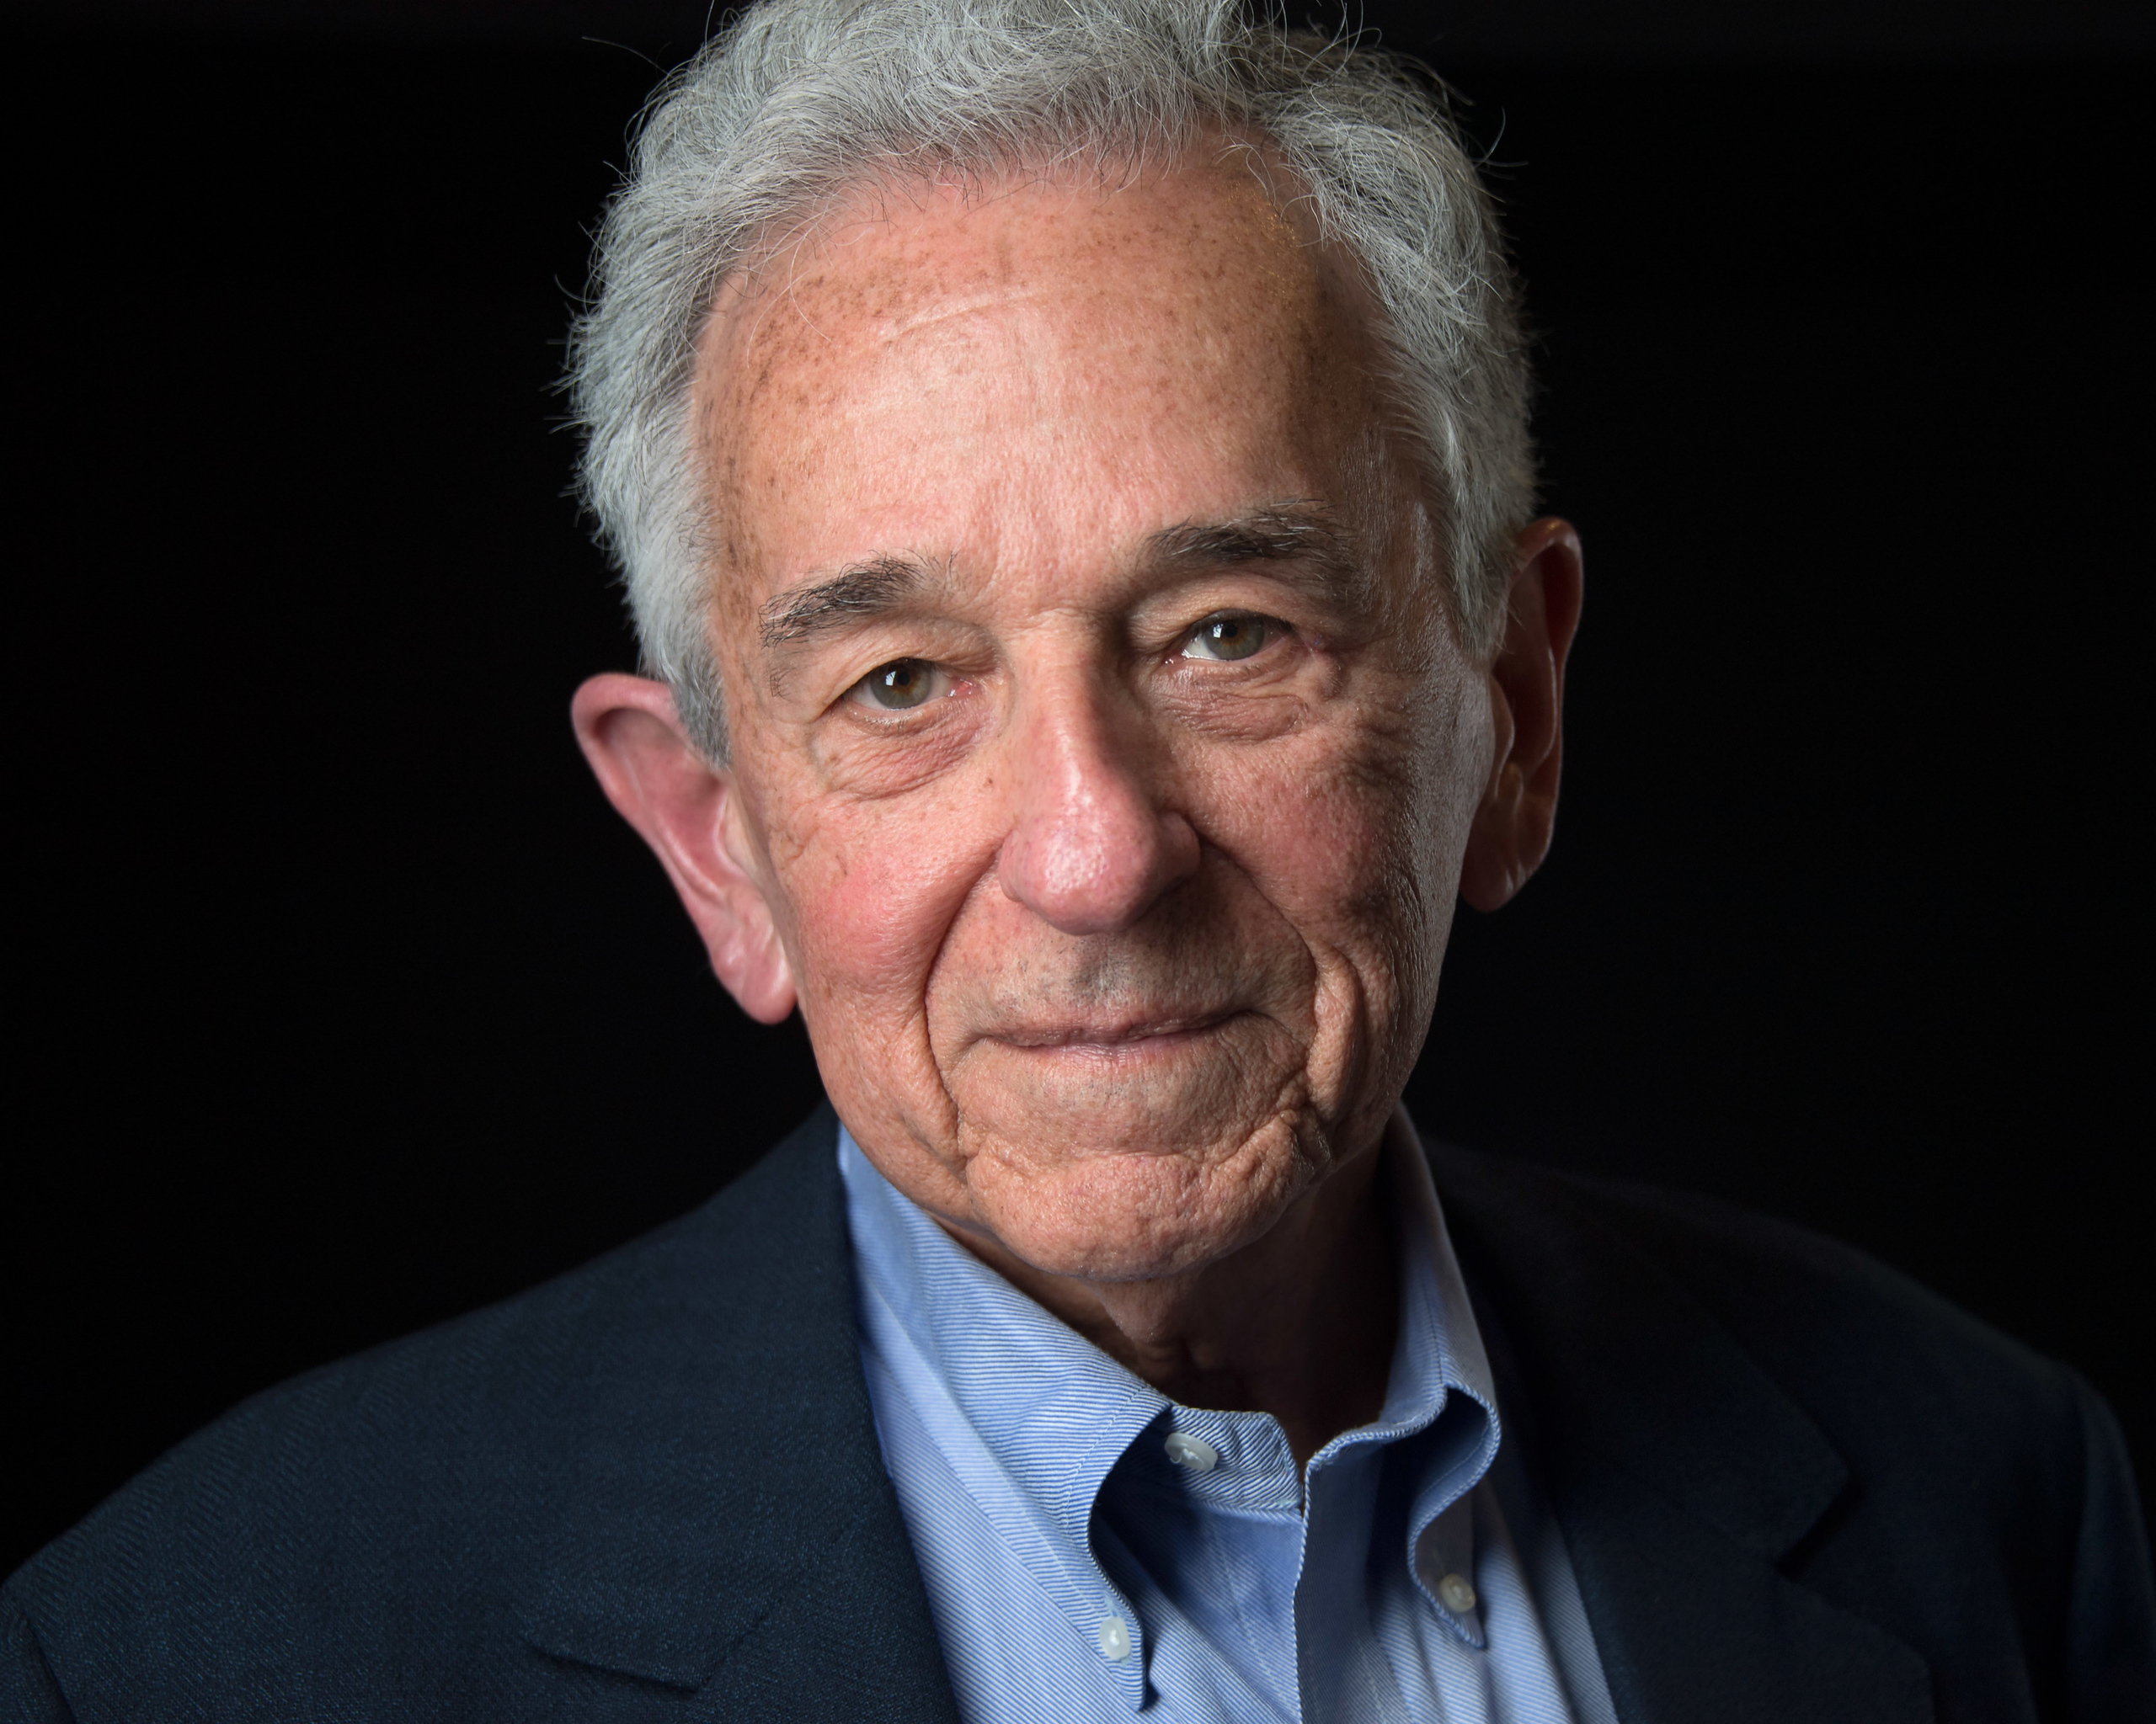
Jeff Rulifson

Slide 9
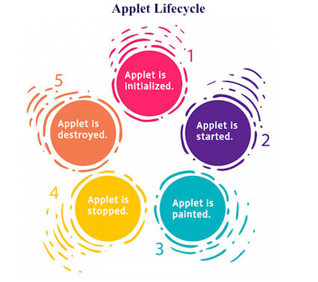

Slide 10
Algorithm
1. Start
2. Import java.applet
3. Import java.awt
4. Import java awt.event
5. Declare Applet “Signal”
6. On Click Statement
1. If String msg = “Stop”, then go to step
2. If String msg = “Ready”, then go to step
3. If String msg = “Go”, then go to step
7. Initiate Class Graphics
8. Execute msg.equals("Stop")()
9. Execute msg.equals("Ready")()
10. Execute msg.equals("Go")()
11.Stop

Slide 11
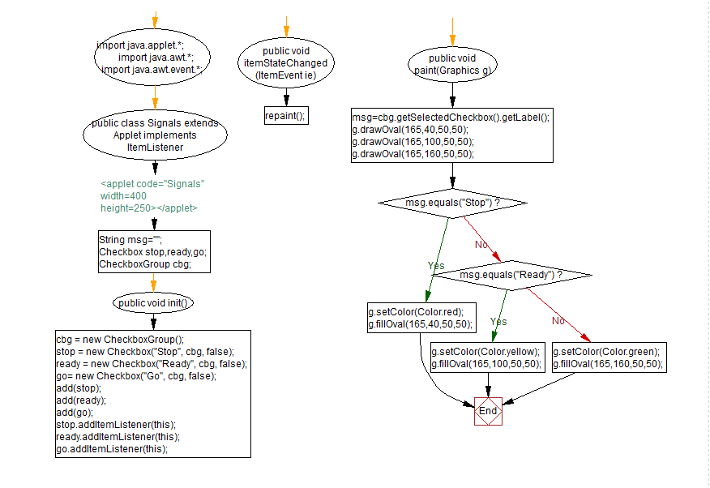
Flowchart

Slide 12
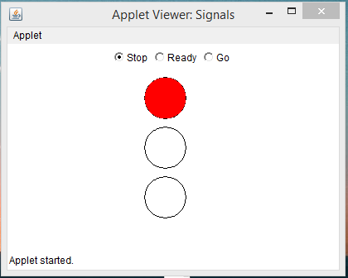
Output
When Stop Button is selected

Slide 13
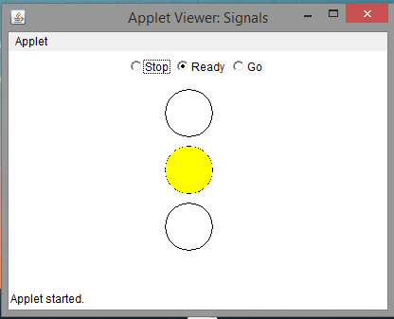
Output
When Ready Button is selected

Slide 14
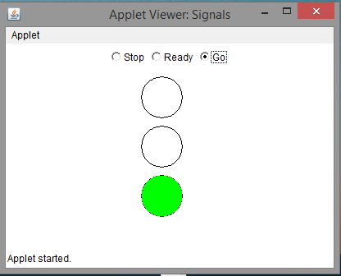
Output
When Go Button is selected

Slide 15

Analysis
The goal of Java is to make all implementations of Java compatible.
The Java programming language requires the presence of a software platform in order for compiled programs to be executed.
Oracle supplies the Java platform for use with Java. The Android SDK is an alternative software platform, used primarily for developing Android applications with its own GUI system.

Slide 16
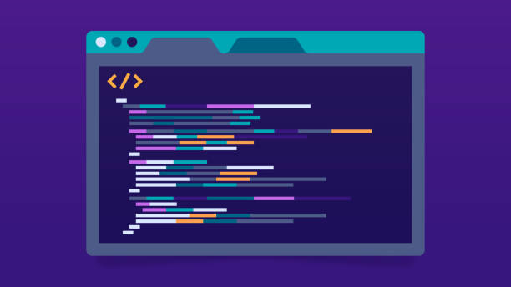
Conclusion
Java was developed by James Gosling in Sun Microystem in 1991.
It promised Write Once, Run Anywhere (WORA) functionality, providing no-cost run-times on popular platforms.
Applet were created by Jeff Rulifson.
They are small applications that runs a specific task.

Slide 17

Thank You!

